Slide 1
Meaning
We meditate on that most adored Supreme Lord, the creator, whose divine light illumines all physical, mental and spiritual being. May this divine light illumine our intellect as well.

Slide 3
29th AUGUST
From 29th August 2012 we have started to celebrate his Birthday as “NATIONAL SPORTS DAY”

Slide 4
Let’s Know more about our Wizard of Hockey

Slide 5
2
Birth date of Dhyan Chand
4
At what age He joined Army?
1
When was National Sports Day first celebrated in India?
3
Who was the first Coach of Dhyan Chand?

Slide 6
2
29 August 1905
4
At 16 Years
1
On 29th August 2012
3
Pankaj Gupta

Slide 7
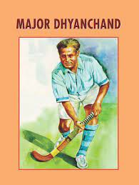
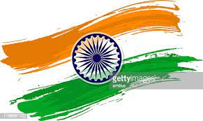
In a major development, Prime Minister Narendra Modi announced that Rajiv Gandhi Khel Ratna Award will now be called The Major Dhyan Chand Khel Ratna award.
Notes:
Now Teacher will ask the question from students
1: in what age you can start practice for any game?
2: In what age Dhyan Chand started to play?
3: in what age he joined Army ?
4: What is the mantra of success?
Now Teacher will explain that If ypu want to do something good in any field than you should not wait for last moment you should put our effort from the beginning, so like this those Students want to get good marks in Board exam they should put their effort from the lower classes, they should not wait for tomorrow just star from Today then you will get success…

Slide 8
Presented By Kamana Chaudhari

